Slide 1

Covid 19 Analysis and Risk Prediction
Presented to you by:
Raed Habib

Slide 2


Agenda
Introduction
Overview
Dataset Overview
Initial Questions to be Answered
Exploratory Data Analysis
Data Pre-processing and Problems
Modeling and Results
Conclusion

Slide 3

Introduction
Coronavirus disease (COVID-19) is an infectious disease caused by a newly discovered coronavirus. Most people infected with COVID-19 virus will experience mild to moderate respiratory illness and recover without requiring special treatment. Older people, and those with underlying medical problems like cardiovascular disease, diabetes, chronic respiratory disease, and cancer are more likely to develop serious illness.

Slide 4

Introduction
During the entire course of the pandemic, one of the main problems that healthcare providers have faced is the shortage of medical resources and a proper plan to efficiently distribute them. In these tough times, being able to predict what kind of resource an individual might require at the time of being tested positive or even before that will be of immense help to the authorities as they would be able to procure and arrange for the resources necessary to save the life of that patient.

Slide 5

Project goal
The main goal of this project is to build a machine learning model that, given a Covid-19 patient's current symptom, status, and medical history, will predict whether the patient is at high risk or not.

Slide 6
Dataset Overview
The dataset is obtained from Kaggle at the following link:
https://www.kaggle.com/datasets/meirnizri/covid19-dataset, and was provided by the Mexican government, which can be found at this link:
https://datos.gob.mx/busca/dataset/informacion-referente-a-casos-covid-19-en-mexico
This dataset contains an enormous number of anonymized patient-related information including pre-conditions. The raw dataset consists of 21 unique features and 1,048,576 unique patients. In the Boolean features, **1 means "yes" and 2 means "no". values as 97 and 99 are missing data**.

Slide 7
Dataset Overview
sex: 1 for female and 2 for male.
**sex**: 1 for female and 2 for male.
age: of the patient.
classification: Covid test findings. Values 1-3 mean that the patient has Covid in different degrees. 4 or higher means that the patient is not a carrier of Covid or that the test is inconclusive.
patient type: type of care the patient received in the unit. 1 for returned home and 2 for hospitalization.
pneumonia: whether the patient already have air sacs inflammation or not.
pregnancy: whether the patient is pregnant or not.
diabetes: whether the patient has diabetes or not.

Slide 8
Dataset Overview
copd: Indicates whether the patient has Chronic obstructive pulmonary disease or not.
**sex**: 1 for female and 2 for male.
asthma: whether the patient has asthma or not.
inmsupr: whether the patient is immunosuppressed or not.
hypertension: whether the patient has hypertension or not.
cardiovascular: whether the patient has heart or blood vessels related disease.
renal chronic: whether the patient has chronic renal disease or not.
other disease: whether the patient has other disease or not.

Slide 9
Dataset Overview
obesity: whether the patient is obese or not.
**sex**: 1 for female and 2 for male.
tobacco: whether the patient is a tobacco user.
firusmr: Indicates whether the patient treated medical units of the st, second or third level.
medical unit: type of institution of the National Health System that provided the care.
Intubed:whether the patient was connected to the ventilator.
icu: Indicates whether the patient had been admitted to an Intensive Care Unit.
date died: If the patient died indicate the date of death, and 9999-99-99 otherwise.

Slide 10

Initial Questions to be Answered:

Slide 11

Initial Questions to be Answered:
1- How many people have died?
2- And, did they all have the same results?
3- Is it true that age has some impact?
4- Does Obesity have any impact
5- Does gender have any impact?
6- How do other diseases affect the patient classification?
7- How many patients were diagnosed with Covid 19 of 1st, 2nd, or 3rd degrees?
8- How many of them have died?
9- How many patients were hospitalized?
10- How many of them have died?
11- How many patients had been admitted to an Intensive Care Unit?
12- How many of them have died?

Slide 12
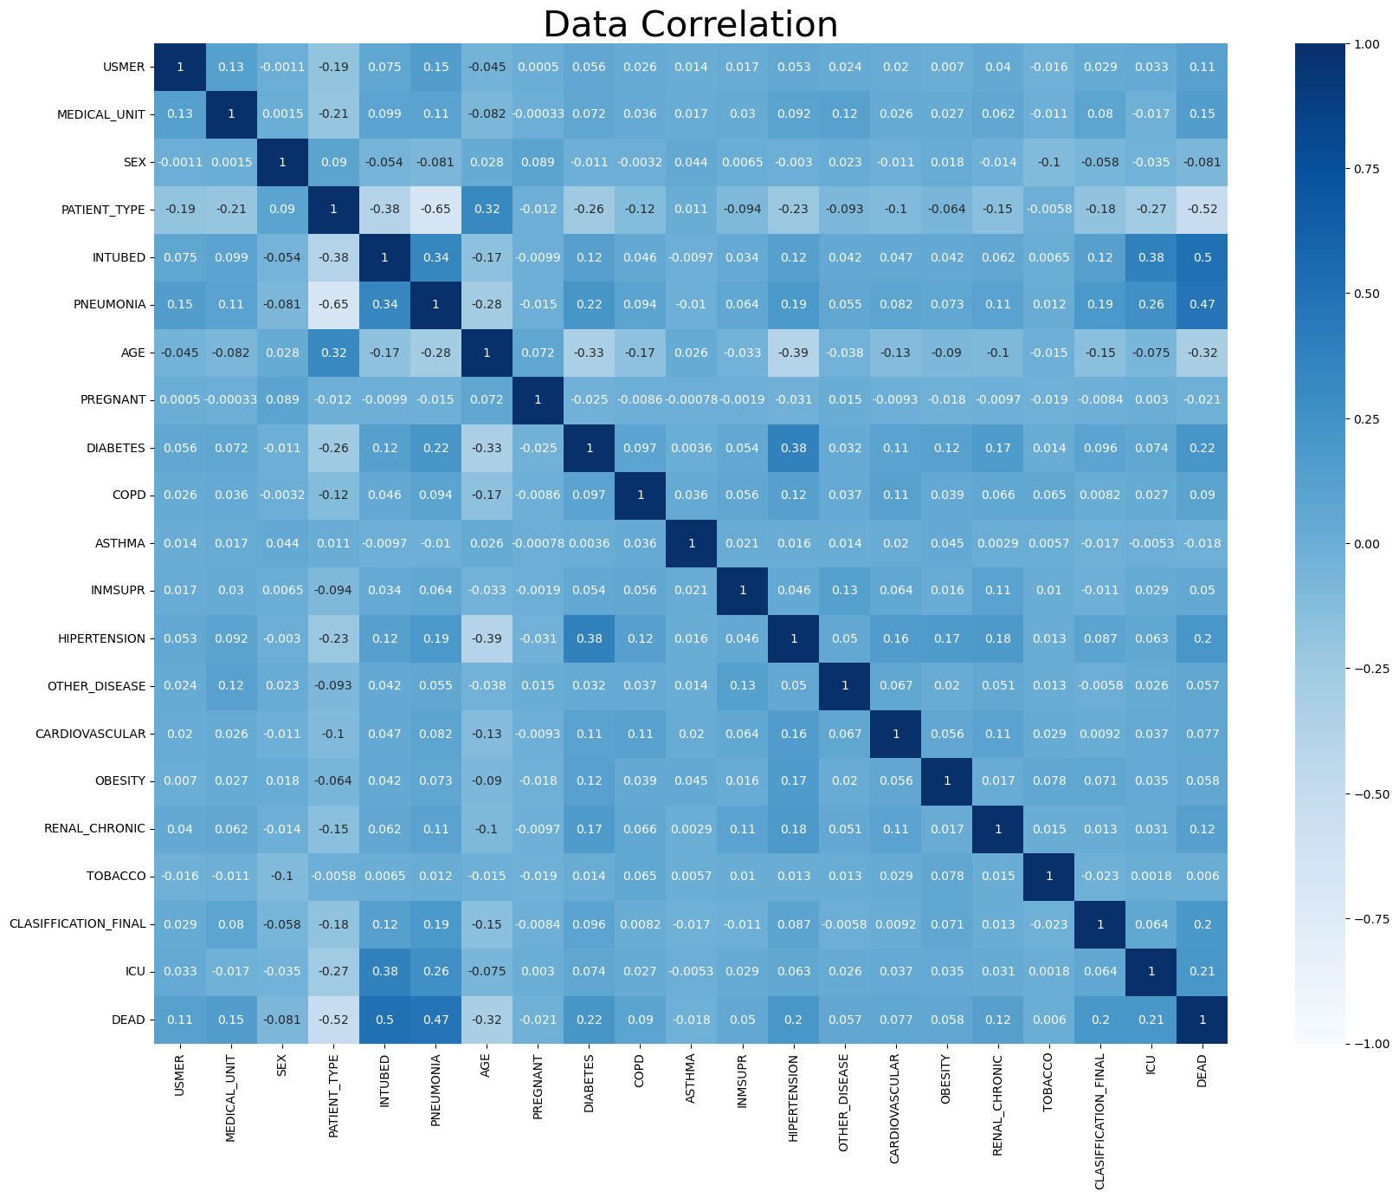
Exploratory Data Analysis

Slide 13
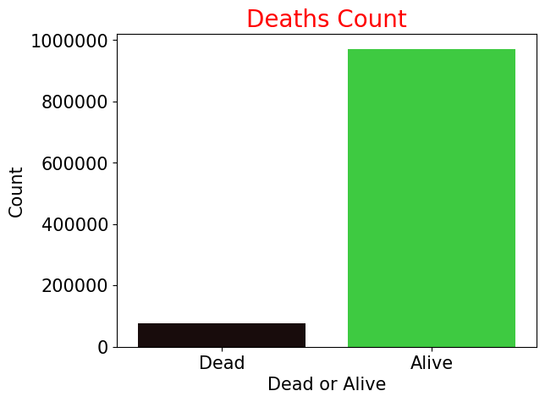
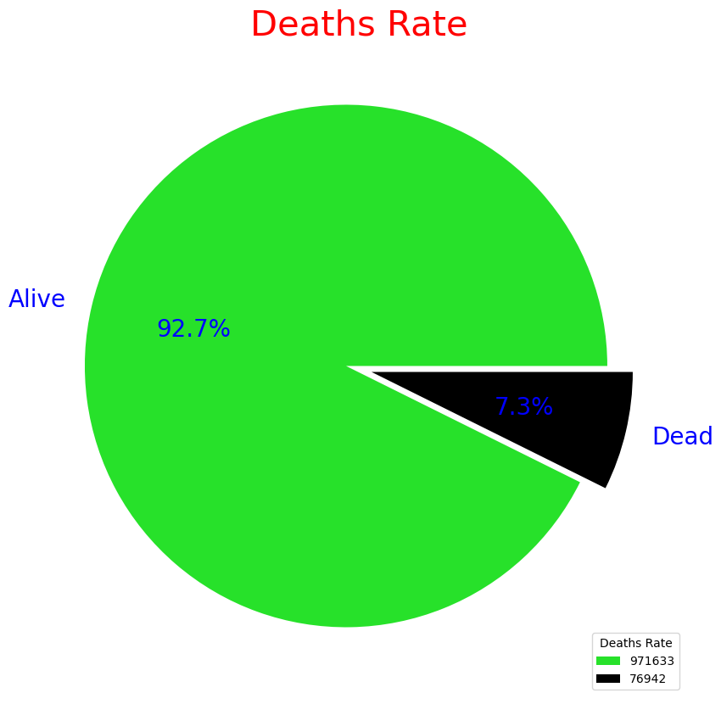
Exploratory Data Analysis

Slide 14
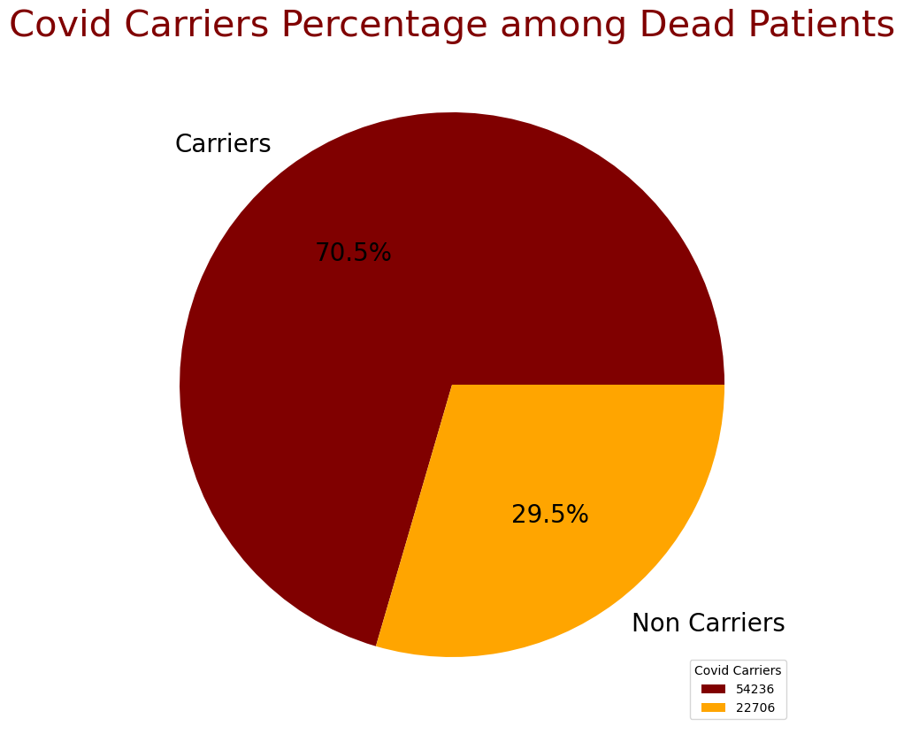
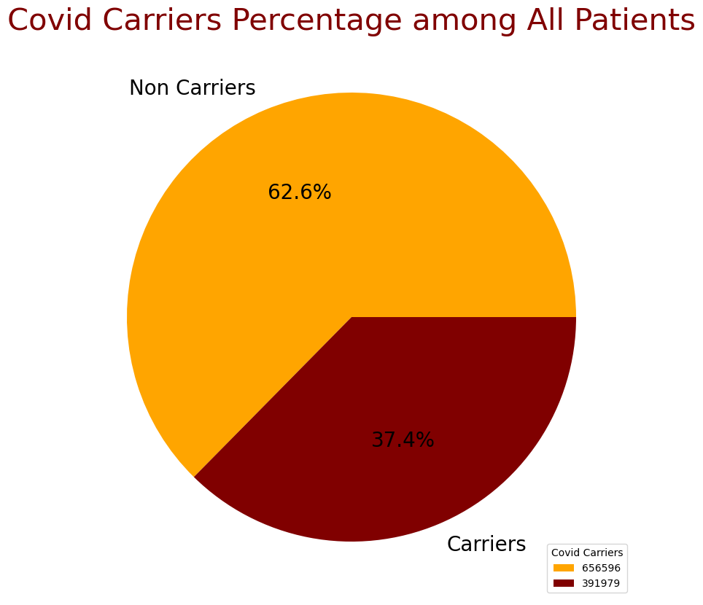
Exploratory Data Analysis

Slide 15
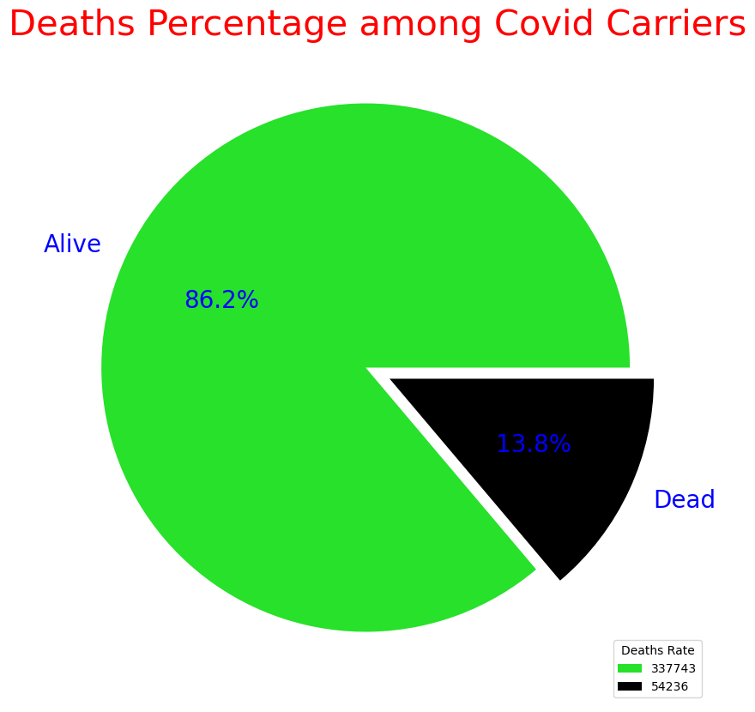
Exploratory Data Analysis

Slide 16
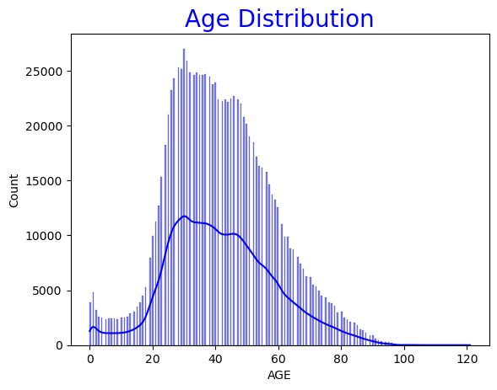
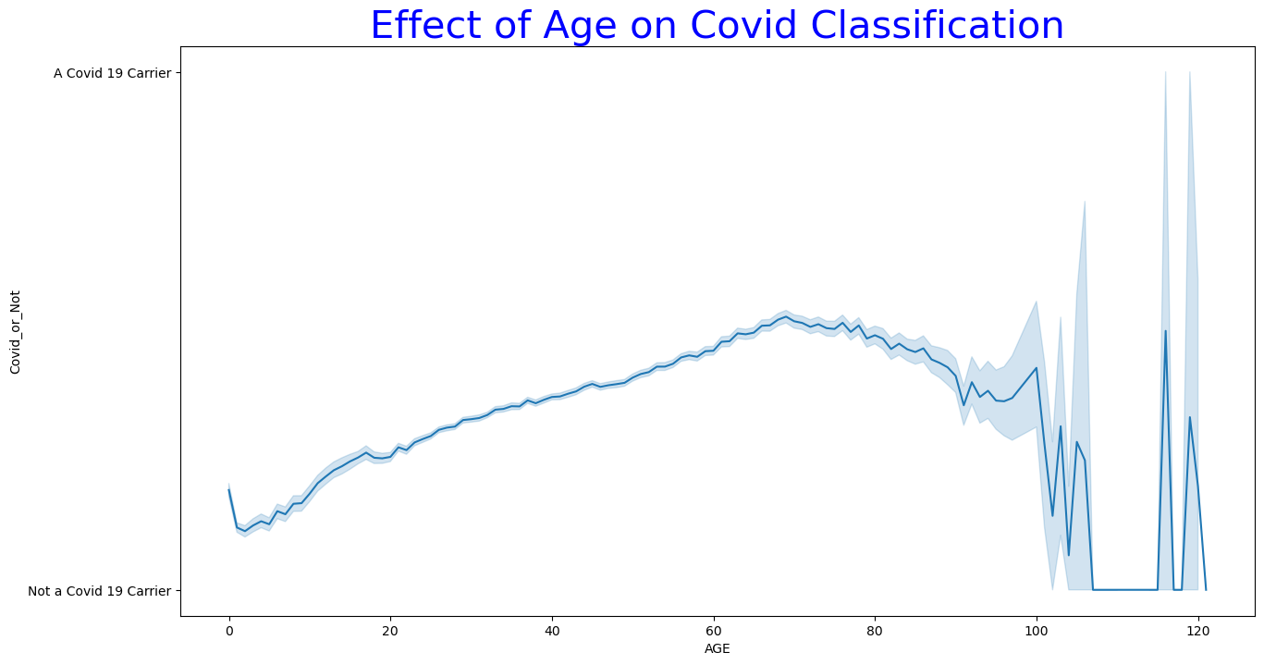
Exploratory Data Analysis

Slide 17
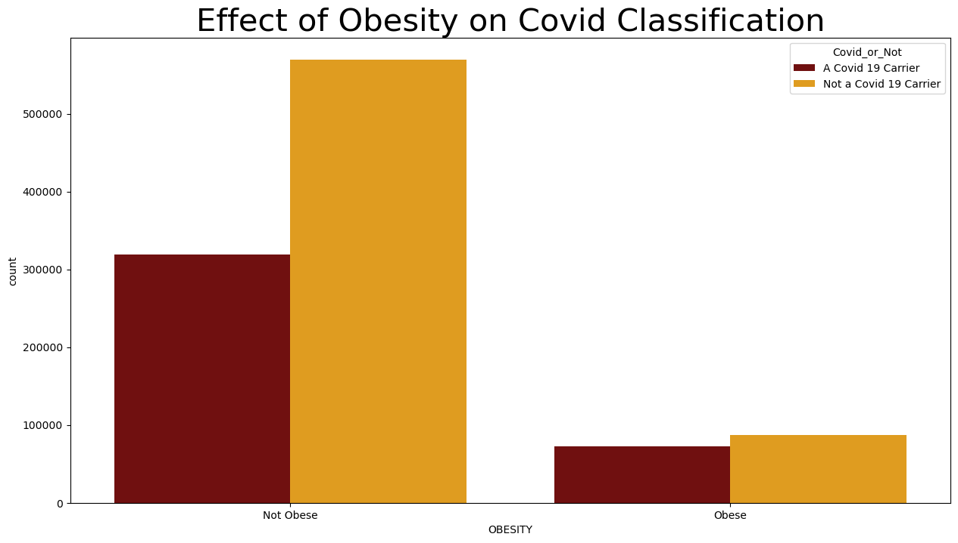
Exploratory Data Analysis

Slide 18
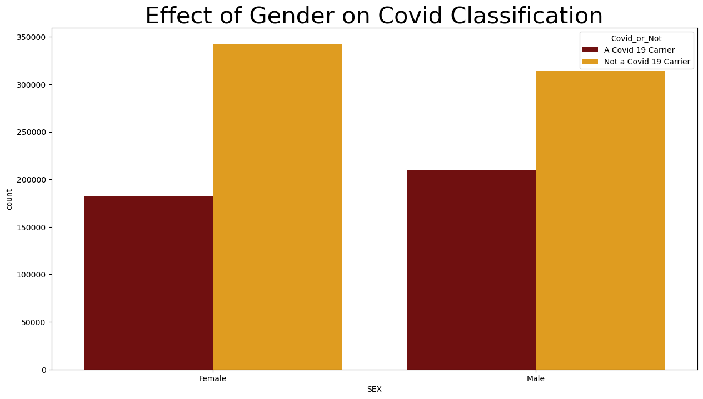
Exploratory Data Analysis

Slide 19
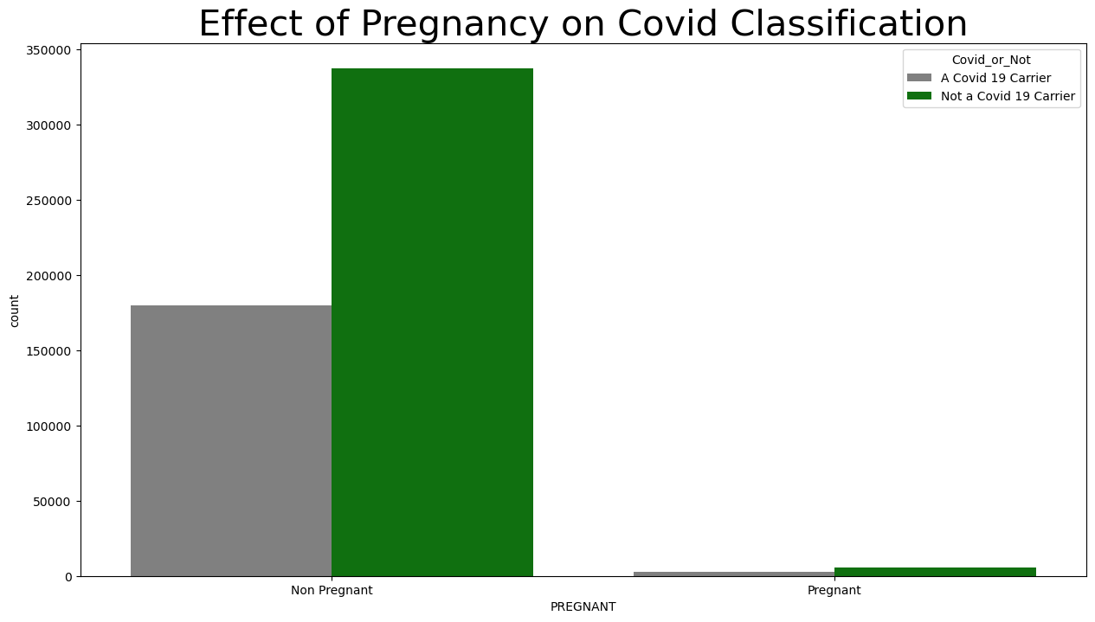
Exploratory Data Analysis

Slide 20
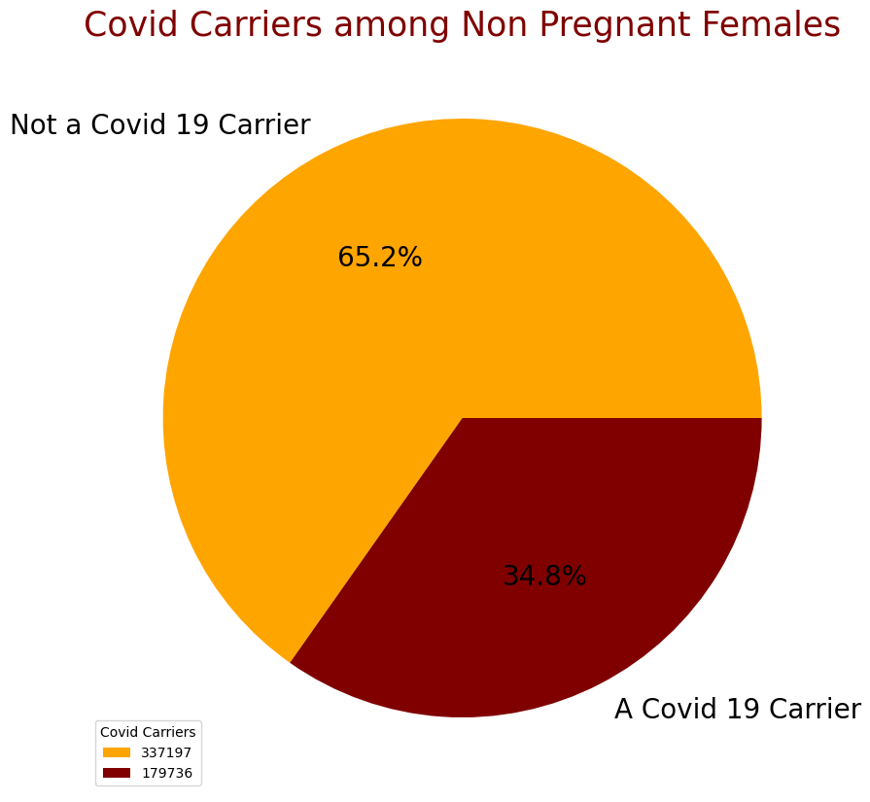
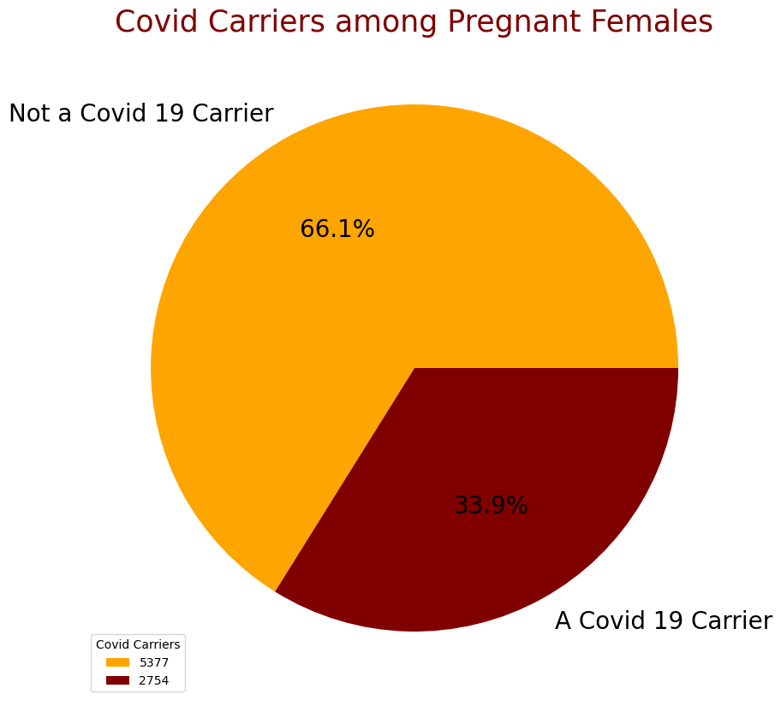
Exploratory Data Analysis

Slide 21
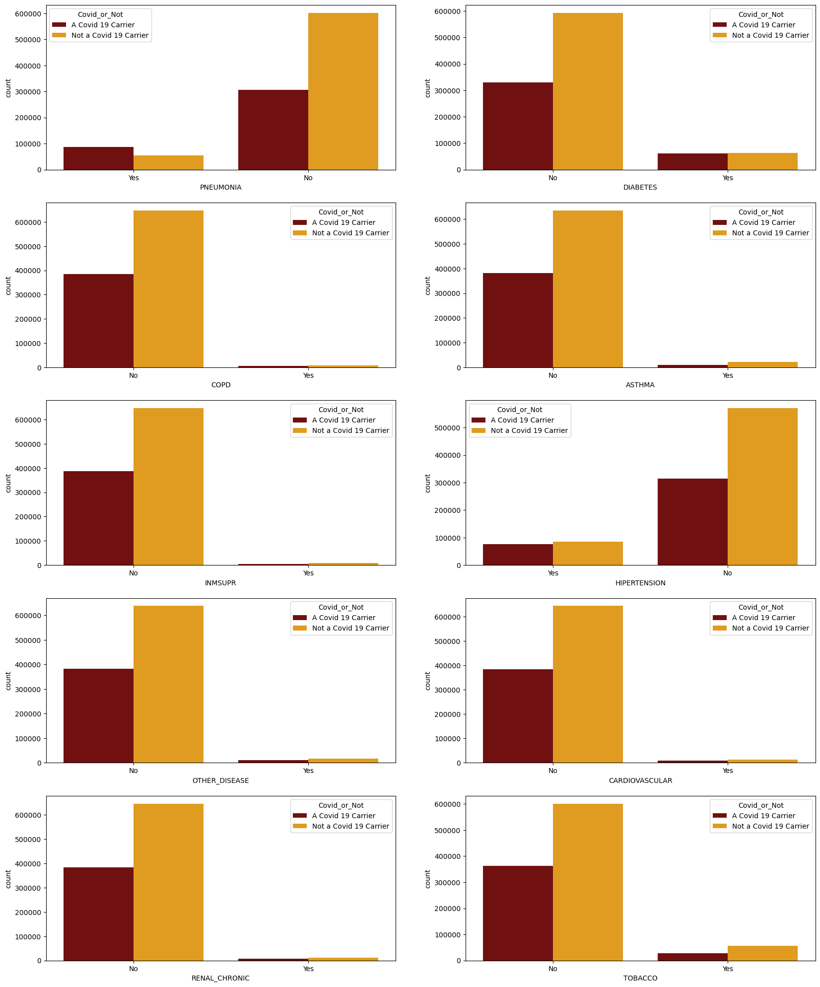
Exploratory Data Analysis
Effect of Diseases on Covid Classification

Slide 22
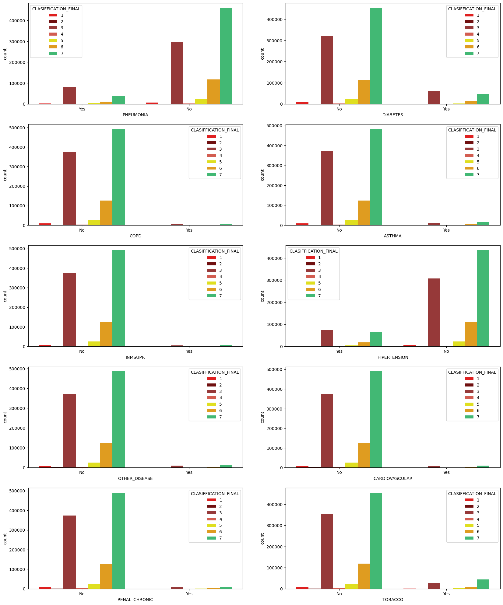
Exploratory Data Analysis
Effect of Diseases on Covid Classification

Slide 23
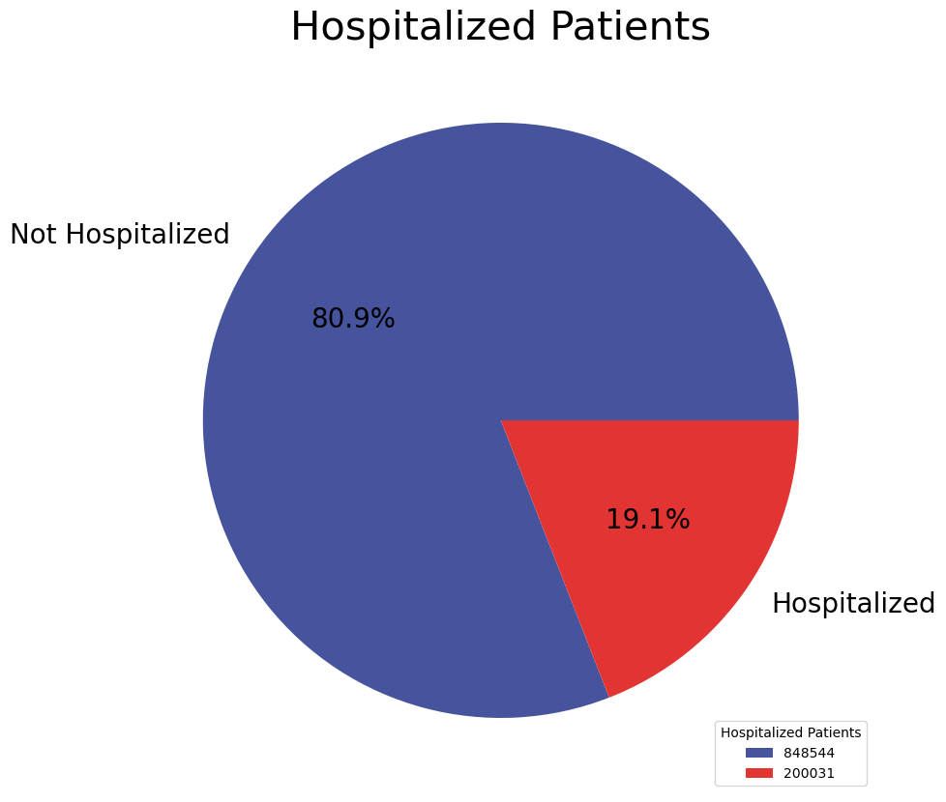
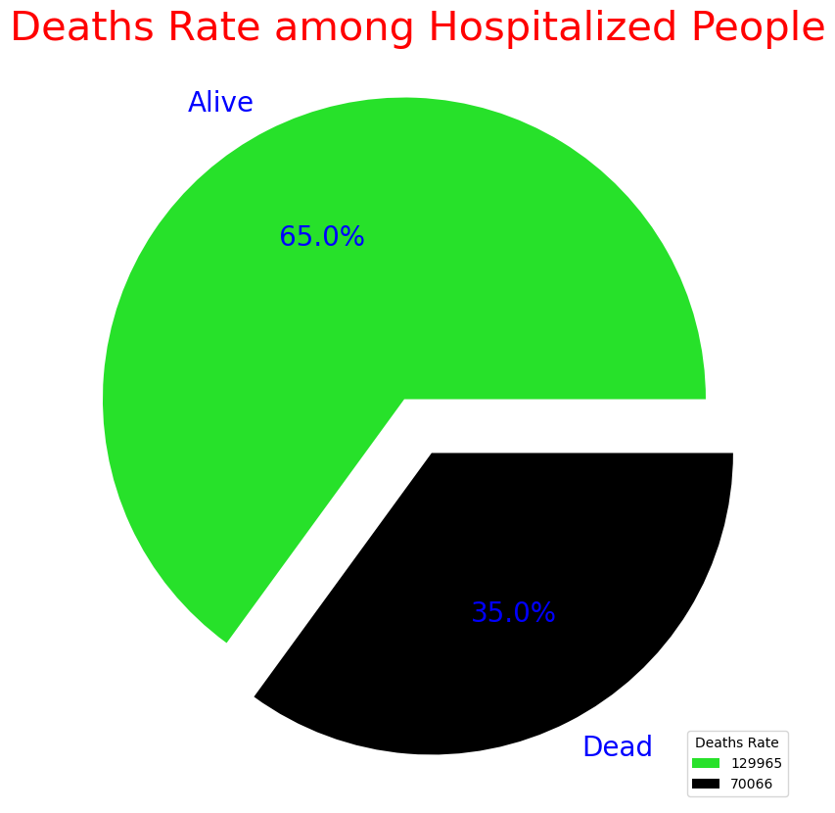
Exploratory Data Analysis

Slide 24
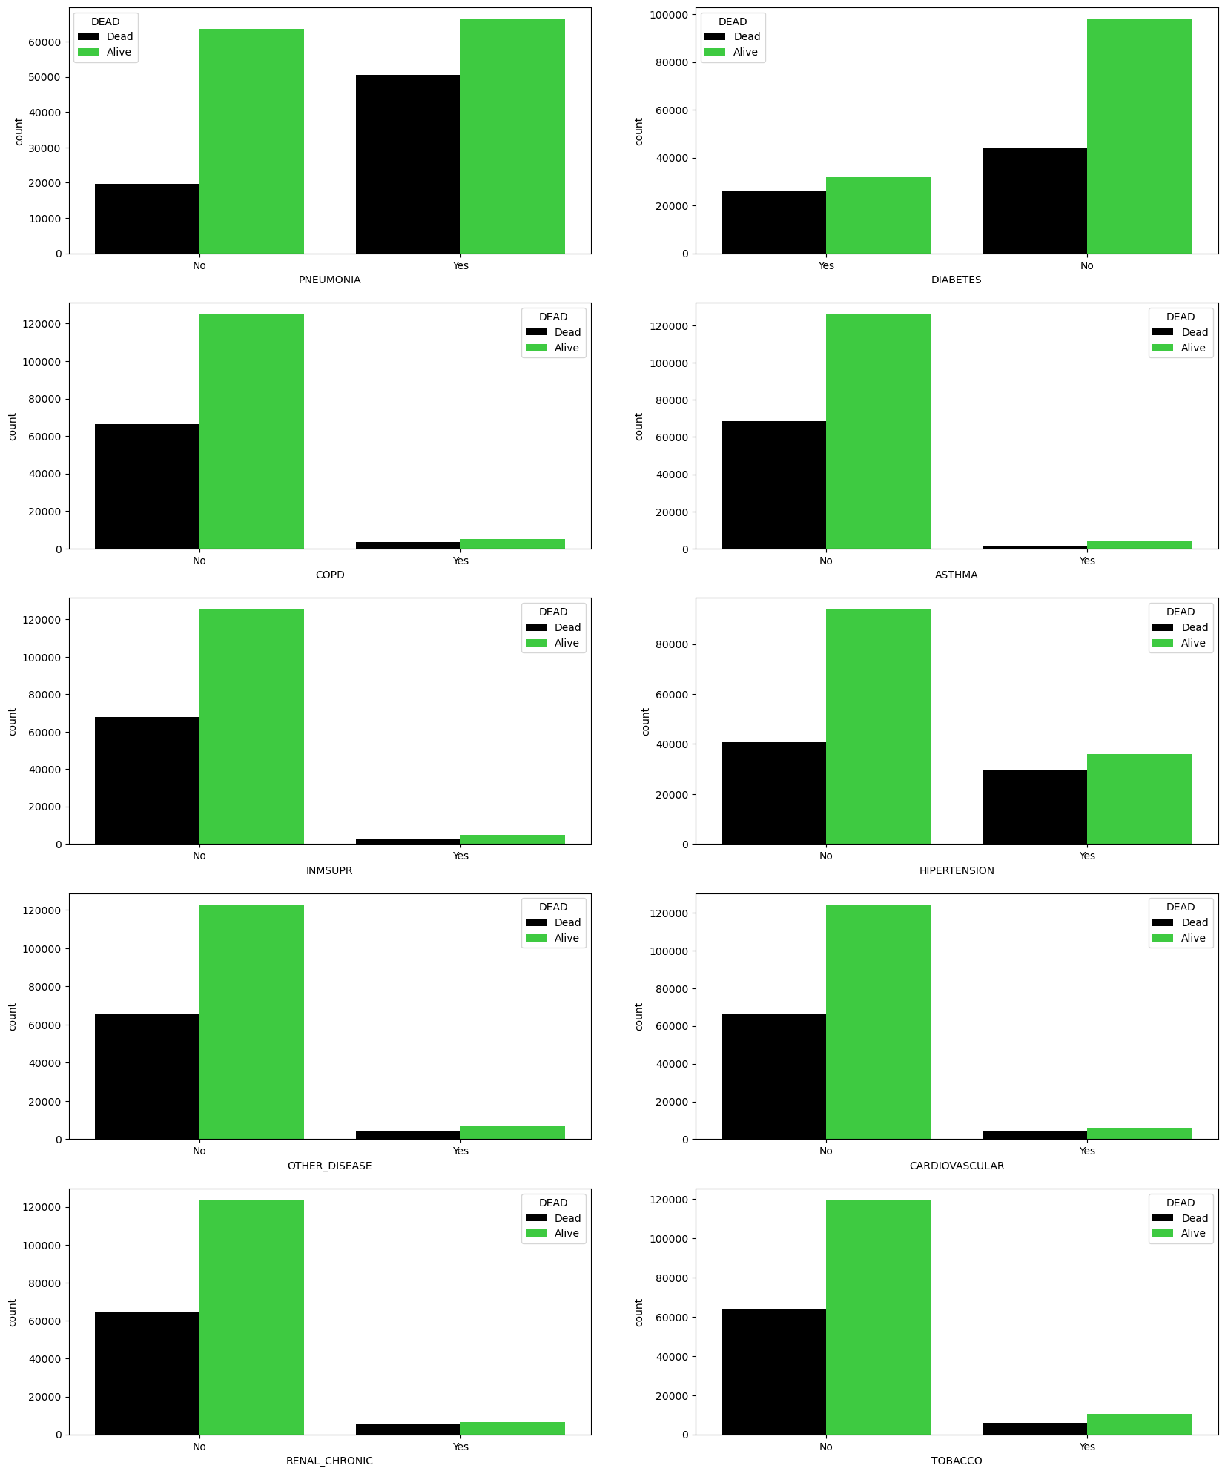
Exploratory Data Analysis
Effect of Diseases on Dead Patients (35%)

Slide 25
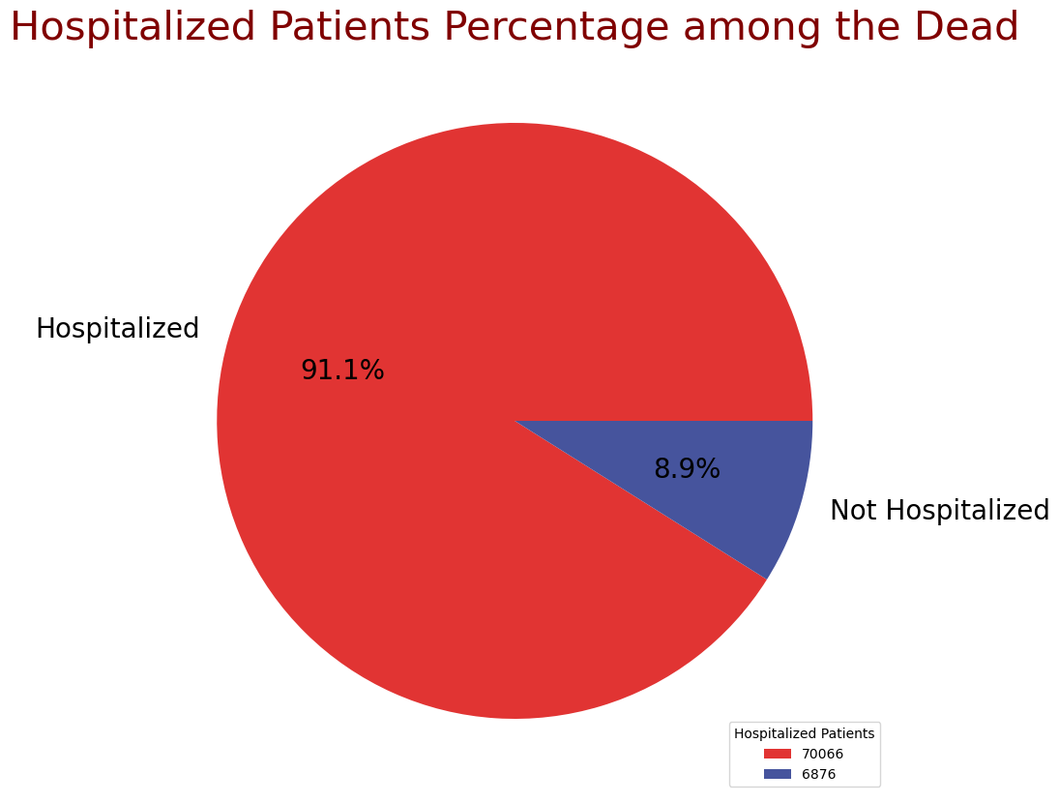
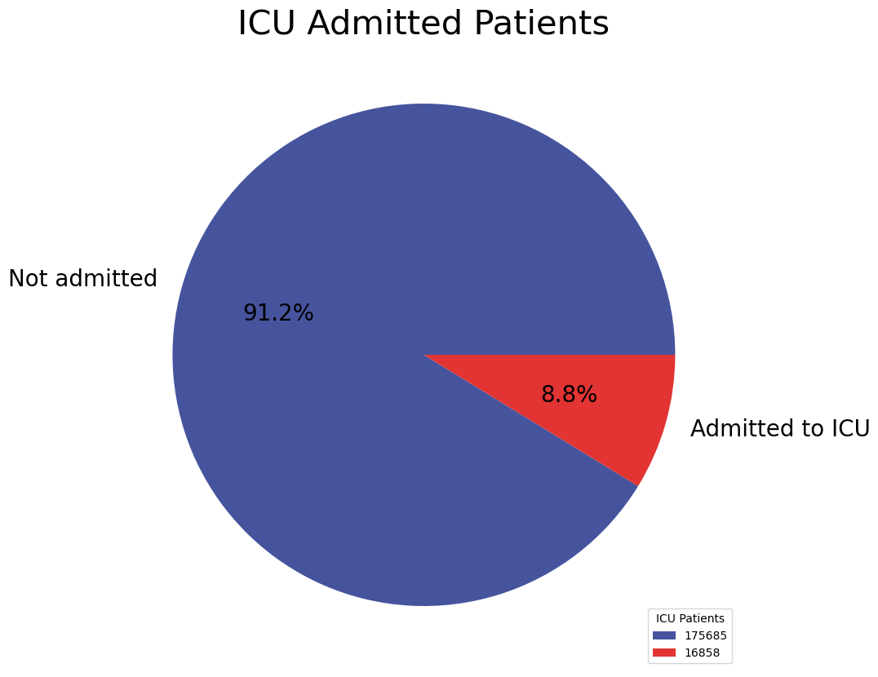
Exploratory Data Analysis

Slide 26
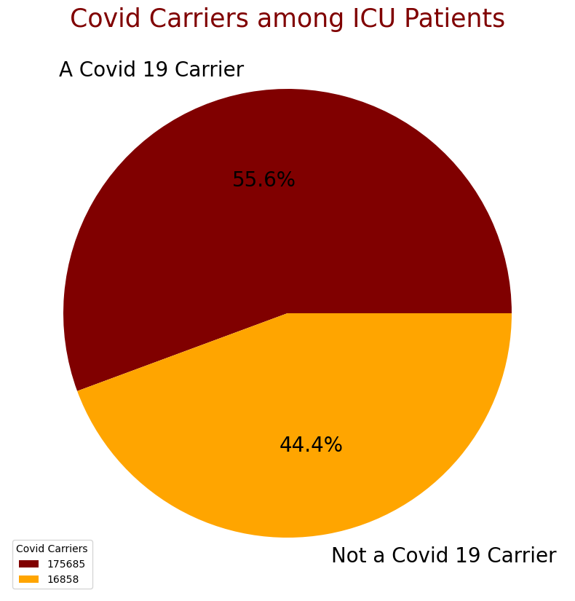
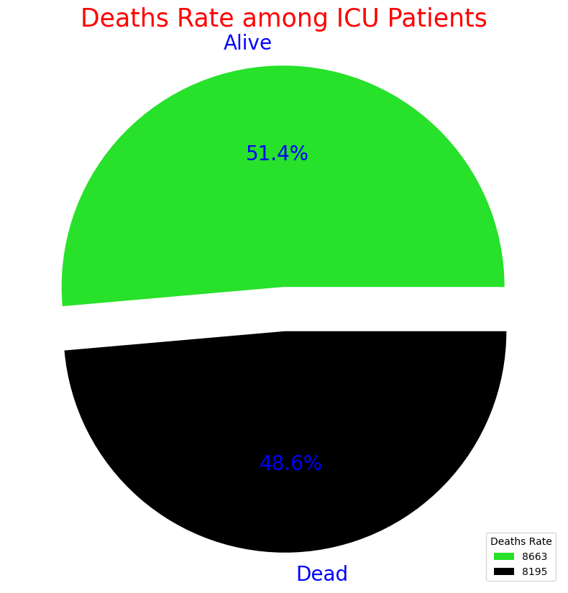
Exploratory Data Analysis

Slide 27
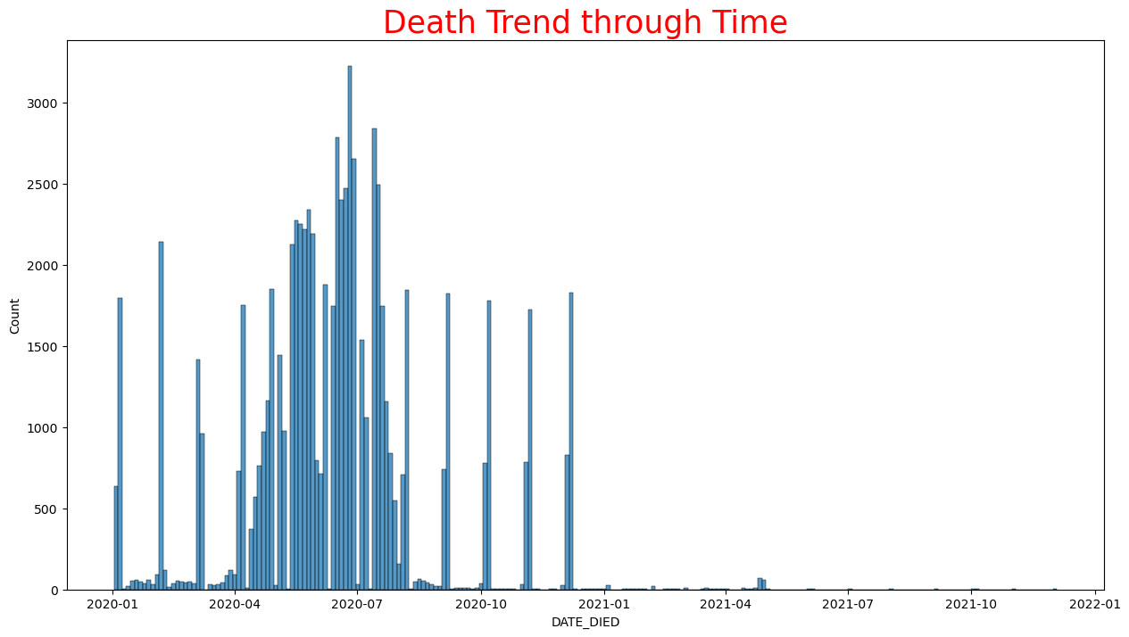
Exploratory Data Analysis

Slide 28

Data Pre-processing and Problems

Slide 29
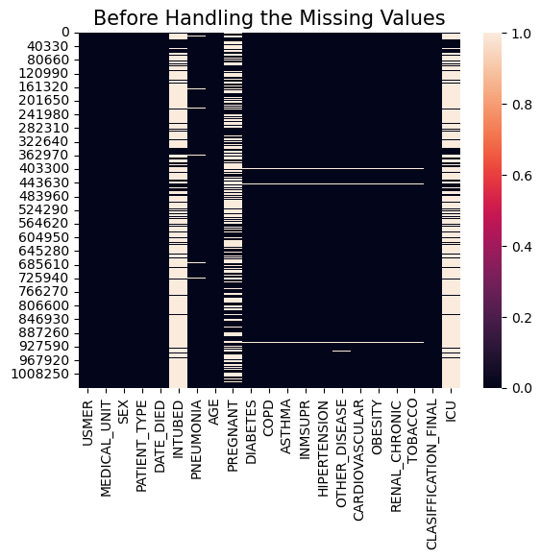
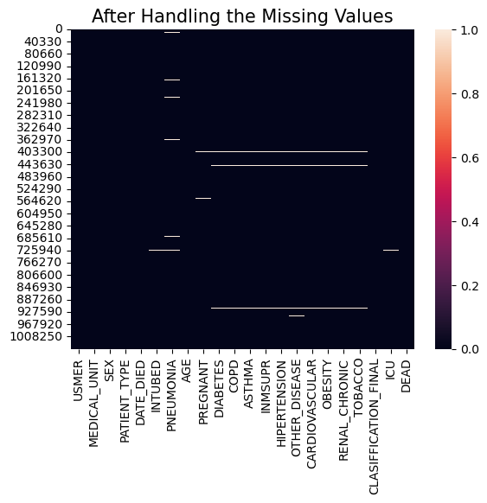
Data Pre-processing and Problems

Slide 30
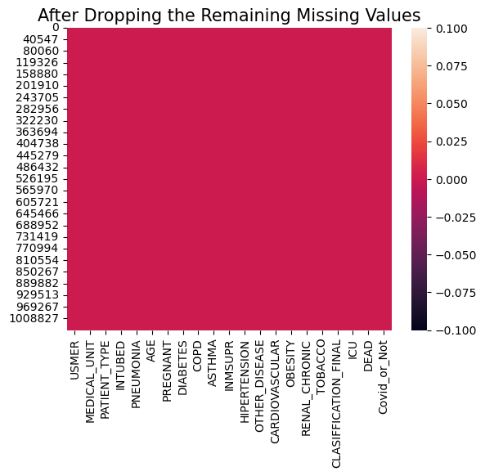
Data Pre-processing and Problems

Slide 31
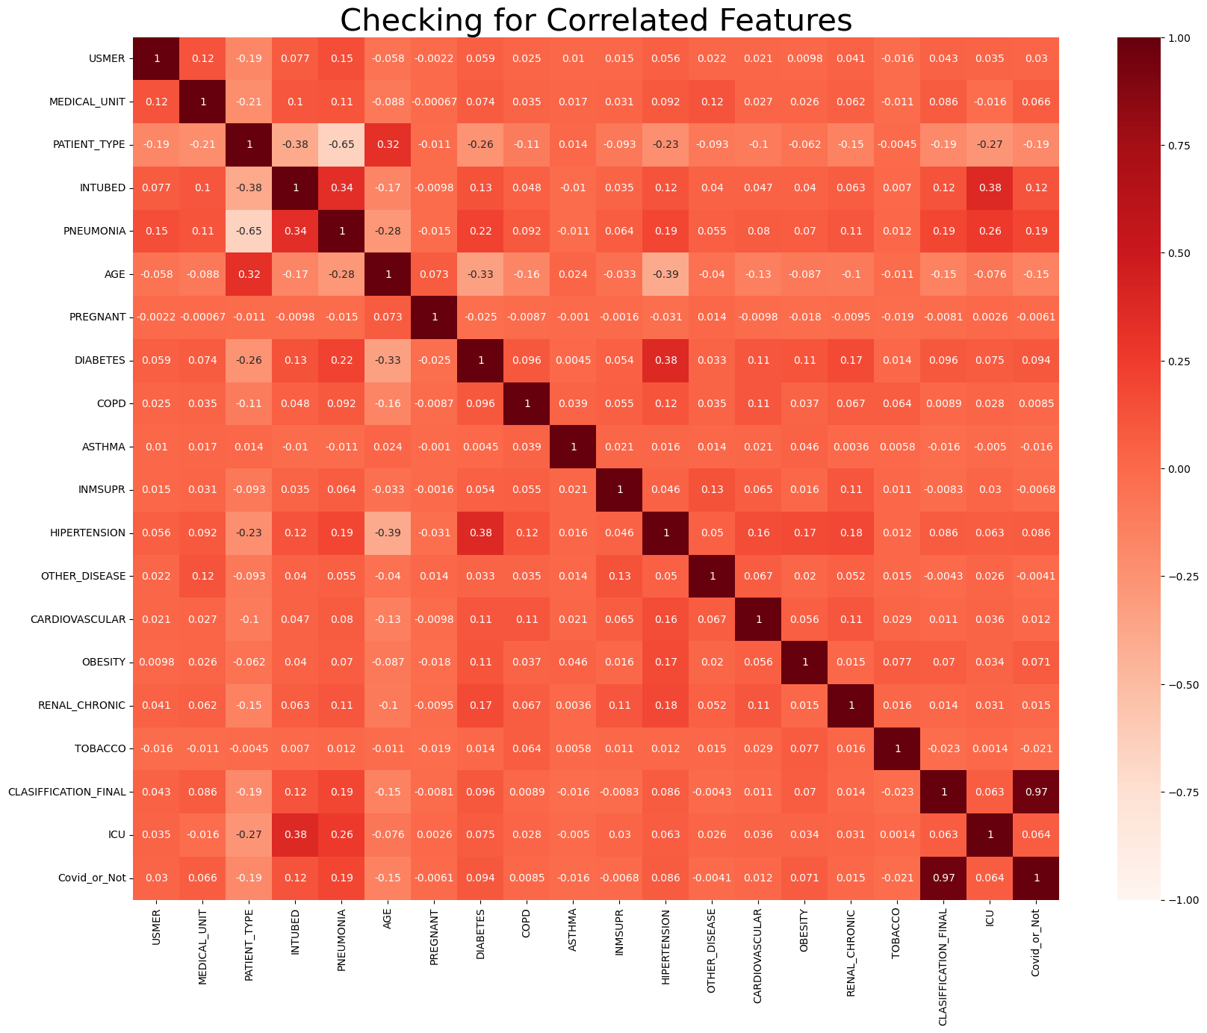
Data Pre-processing and Problems

Slide 32
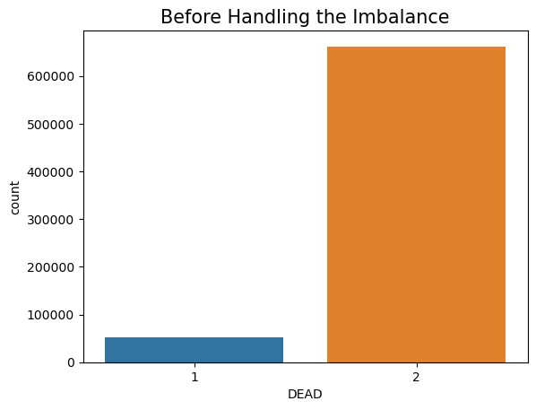
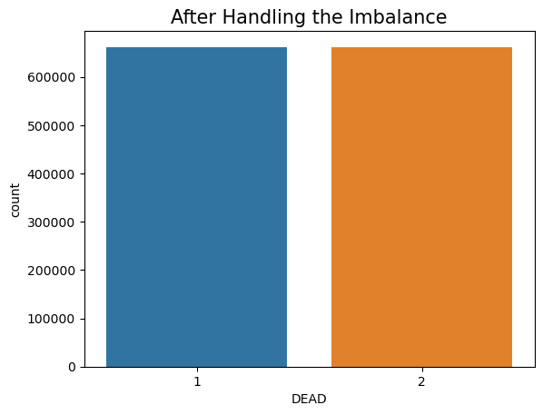
Data Pre-processing and Problems

Slide 33
Modeling and Results
Algorithm Used (Model) | Accuracy (Result)
Logistic Regression | 90%
Decision Tree | 92.1%
Random Forest | 90.3%
Naive Bayes | 88.1%

Slide 34
Conclusion
Unfortunately 7.3% of the total patients have died, with about 70.5% of them were Covid Carriers
As for the total carriers they were about 37.5% out of the total patients.
About 14% of those carriers have died.
We found that age has a significant impact; as it increases chances of getting the virus increases.
We also found that people who are suffering from obesity are more likely to carry the virus.
As for pregnancy, we couldn't find any impact on Covid classification.
We noticed that patients with "Pneumonia", "Hypertension", "Diabetes" and tobacco users have a great chance of getting the virus with "Pneumonia" patients being the most.

Slide 35
Conclusion
We also noticed that there's a positive correlation between having "Hypertension" and "Diabetes" diseases; as most patients with one of those two diseases are subjected to get the other.
We saw that among all the patients of these diseases the patients classified with 3rd degree of Covid are the highest by far
About 19% of the total patients were hospitalized, with a death percentage of 35%.
The "Pneumonia" disease has the greatest impact on that percentage (35%).
About 91% of the dead patients were hospitalized
About 9% out of the hospitalized patients were admitted to the ICU, with about 56% of them being classified as Covid carriers, and with a great percentage of death of about 49%.

Slide 36
Conclusion
The death was very trending during mid 2020 starting from April up till August.
As for our modeling, we got a high accuracy of 92% using both "Random Forest" and "Decision Tree" algorithms, while both "Logistic Regression" and "Naive Bayes" algorithms didn't fit well with our data.

Slide 37

Thank You!

